Slide 1


Is it a #clone or a #remix?
Tagging Plagiarism in the Classroom

Slide 3
Is it a #clone or a #remix?
Tagging Plagiarism in the Classroom

Slide 4
What is the
Plagiarism Spectrum?

Slide 5
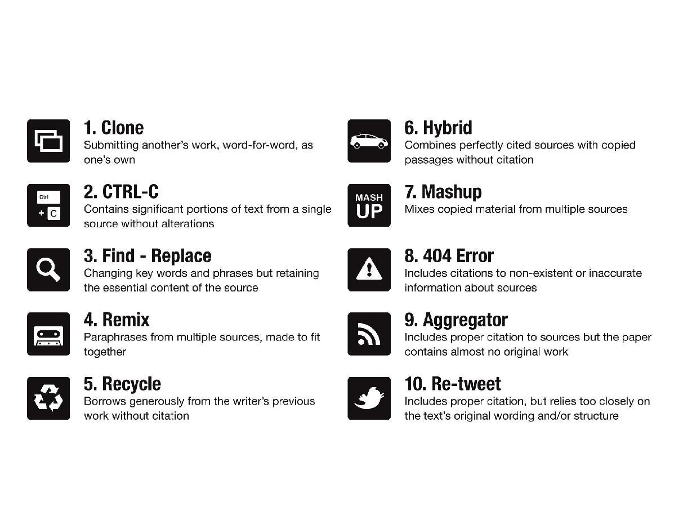
Tagging the 10 Types of Plagiarism
Notes:
The Plagiarism Spectrum is a guide that Turnitin developed to help educators, students, academics, and writers recognize the various forms of plagiarism. This spectrum moves plagiarism beyond the black-and-white definition of “literary theft” to one that captures the nuances of how plagiarism can take form.
The Spectrum is an outcome of the study of thousands of plagiarized papers, providing examples of 10 distinct types of plagiarism that comprise the vast majority of unoriginal work in student papers. These types are defined across a spectrum of intent and have been given titles to reflect both the influence of the Web on plagiarism and to help make the definitions more meaningful to the generation of students who are “digital natives.”
As part of this study (April 2012), Turnitin surveyed both higher and secondary education instructors to take a measure of how prevalent and problematic these instances of plagiarism are among their students. The Plagiarism Spectrum ranks the types of plagiarism by intent and then provides data on the prevalence and problematic nature of type based on the feedback from 879 survey respondents. That feedback is reflected in the visual descriptions of the types that we are going to share with you today.

Slide 6
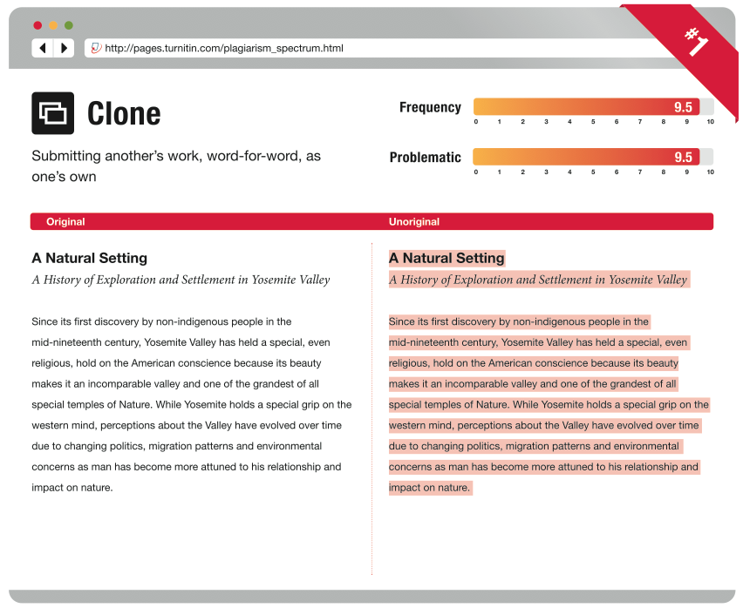
Notes:
At the top is the definition of the type. Below that, you’ll see the “Original” text on the left and next to it the “Unoriginal” version with the questionable text highlighted. In the upper-right hand corner, you’ll see the “Frequency” with which our survey respondents reported how often they’ve seen this type of plagiarism, along with how “Problematic” they thought this type of plagiarism is.
The first one here is “The Clone,” which came in as the most frequent and problematic of all 10 types that our survey respondents reviewed. And as you can see in the Clone, there is an exact 100% match to another text.

Slide 7
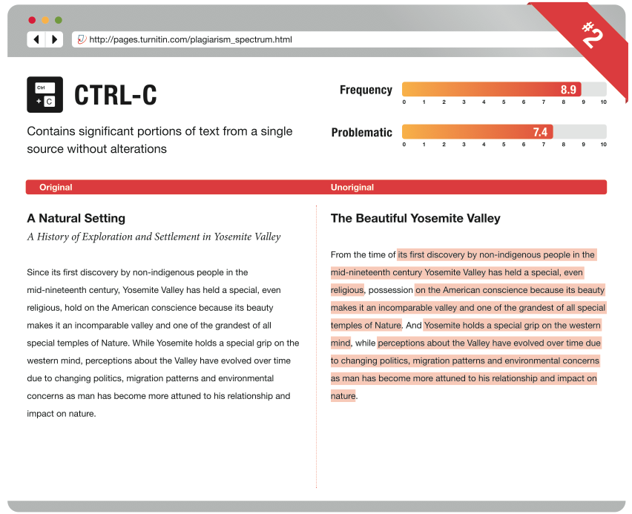
Notes:
Now, moving onto the next type-- “CTRL-C” also known as “copy-and-paste.” Here, you can see that not ALL of the text has been copied. Again, the highlighted text is the text that’s been matched from another source. Frequency for this type is also high as well as the problematic score. The “2” in the very upper right is the rank of this type of plagiarism in terms of its egregiousness or intent.

Slide 8
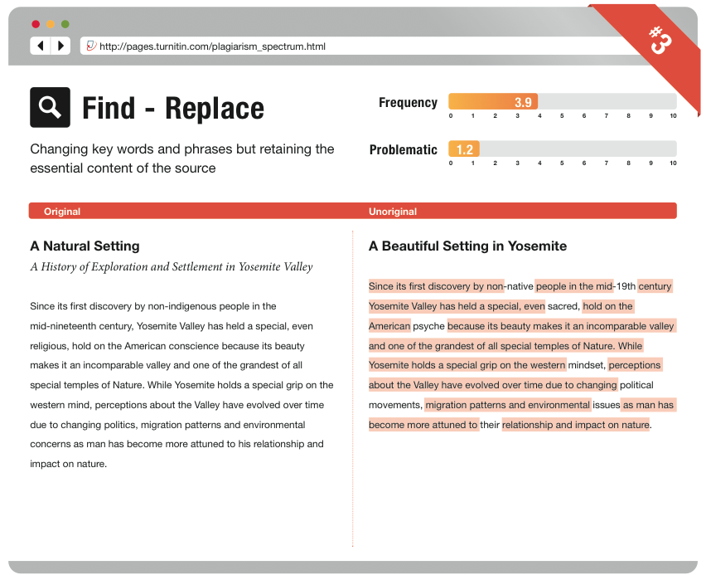
Notes:
The next one is “Find-Replace,” which essentially, yields a moth-ridden version of the original. In find and replace, key words and phrases have been changed but the fundamental content is retained from the original source. Note the frequency and problematic scores.

Slide 9
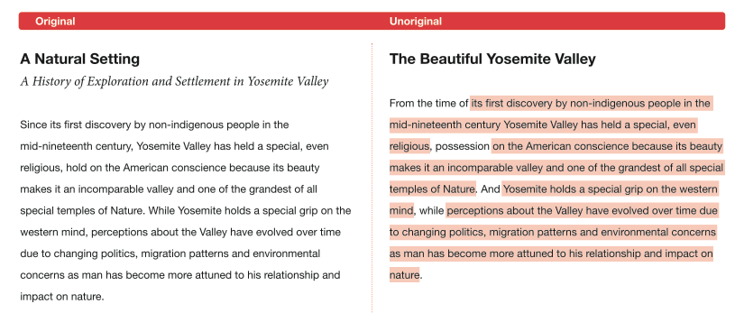
Which Type?
From the three described, this type of plagiarism should be tagged as:
Notes:
Q: Out of the three described thus far, this type of plagiarism should be tagged as:
Put into poll:
Clone
CTRL-C
Find-Replace
A: CTRL-C

Slide 10
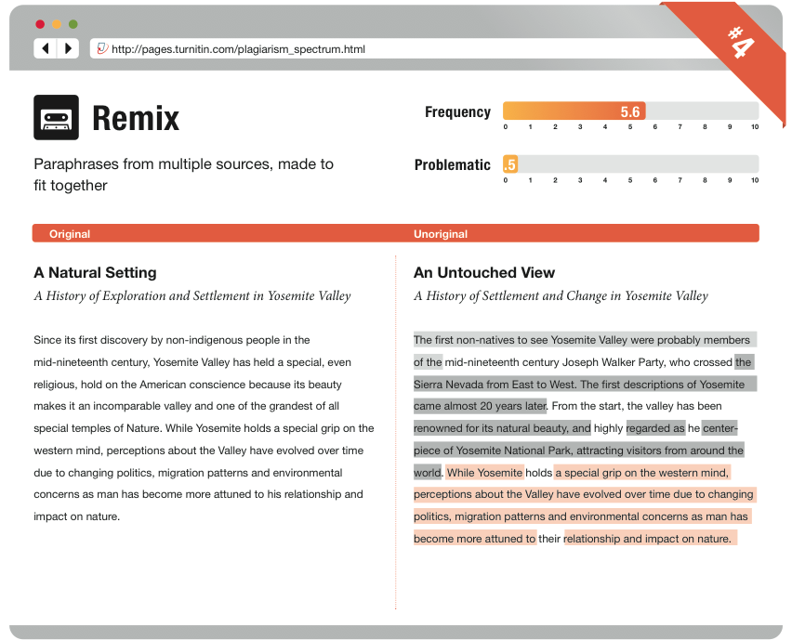
Notes:
“Remix” is a paper that consists of paraphrasing of content from multiple sources. Note the “patchwork” text that emerges from this type of plagiarism. This is low on the “Problematic” front, because instructors typically see “patchwork” writing as a step that emerging writers take when trying to write for a new discipline or about a wholly-new subject matter.

Slide 11
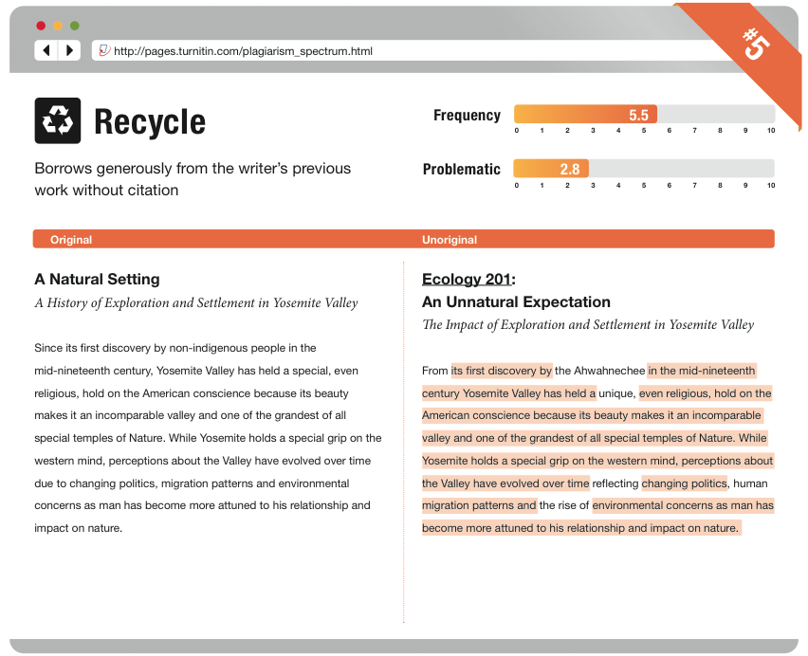
Notes:
The “Recycle” is the paper that was written for one class, but then reappears for a new assignment in a new class. Look at the title changes and the change in the course. Students have a tendency to recycle their own work (hence the higher problematic score). As a general rule of thumb, we suggest that instructors who do not wish to see recycled work include a statement in their syllabi that indicates that only “original work, written for this class is acceptable to fulfill assignment and course requirements.”

Slide 12
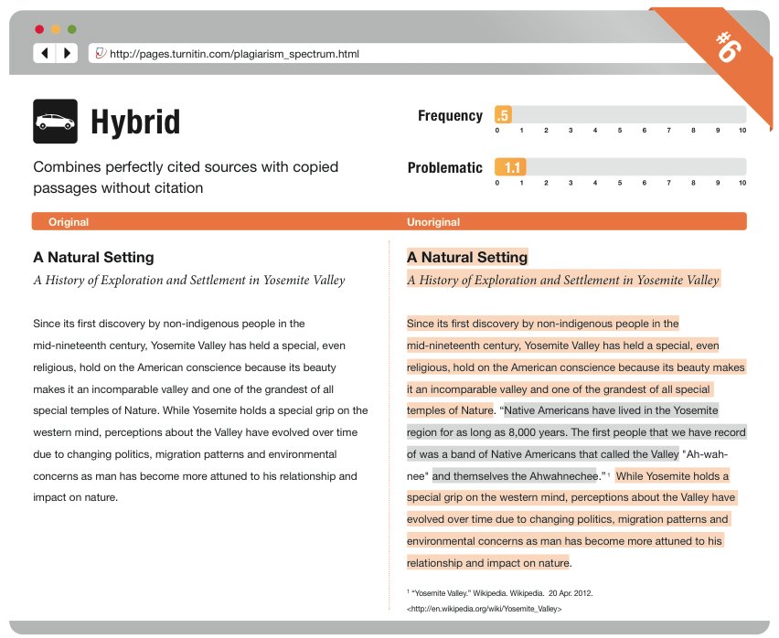
Notes:
The “Hybrid” combines perfectly cited sources and copied passages.

Slide 13
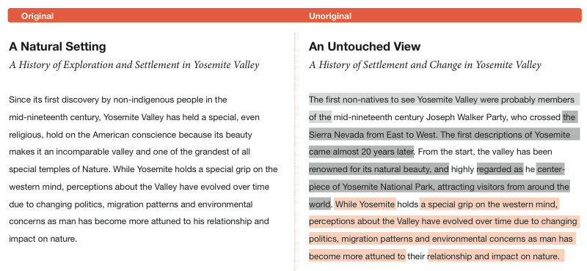
Which Type?
From the six described, this type of plagiarism should be tagged as:
Notes:
Q: Out of the six described thus far, this type of plagiarism should be tagged as:
Put into Poll
- Recycle
CTRL-C
Hybrid
Find-Replace
Remix
Clone
A: Remix

Slide 14
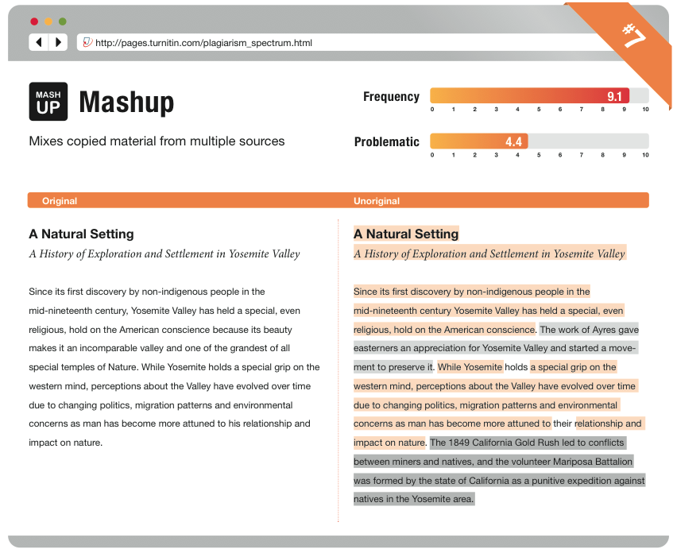
Notes:
At number 7, we have the “mashup.” Which is an act of mixing copied material from different sources. If you look at the highlighted text, you can see clearly that the copy is a visual mashup of content from different sources. Note that the “mashup” is NOT paraphrasing—this is just the act of copying material from a number of sources and putting them together to make a paper. In other words, this is an example of how NOT to do a research paper. Also note how frequently, our survey respondents reported seeing this type of plagiarism.

Slide 15
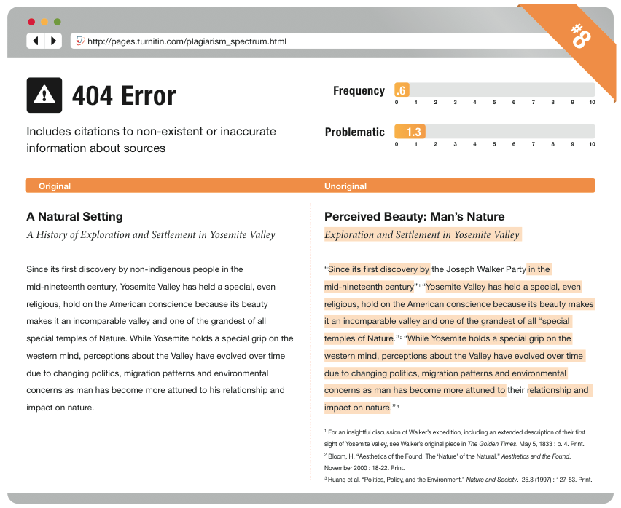
Notes:
At number 8, we have the 404 error. Which is a paper that includes citations to non-existent or inaccurate information about sources.
The “404 Error” happens when students include false or incomplete citations. This is low on the frequently-seen scale--as well as the problematic scale--likely the reflection of errors on the students’ part. Perhaps they’ve forgotten the full citation or have only captured incomplete information about the sources that they’ve used.

Slide 16
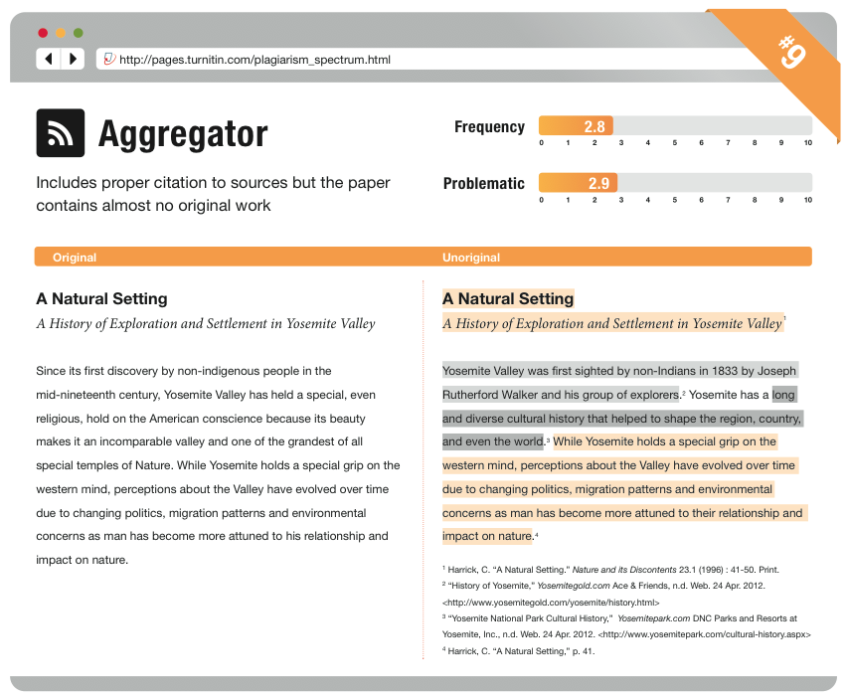
Notes:
At number 9, we have the “Aggregator,” which is the “Mashup” but with proper citation. That is, the aggregator includes proper citation to sources but the paper contains almost no original work. This is what many beginning writers would draft as a “research” paper. Our survey respondents reported encountering this somewhat frequently and saw this as somewhat problematic.

Slide 17
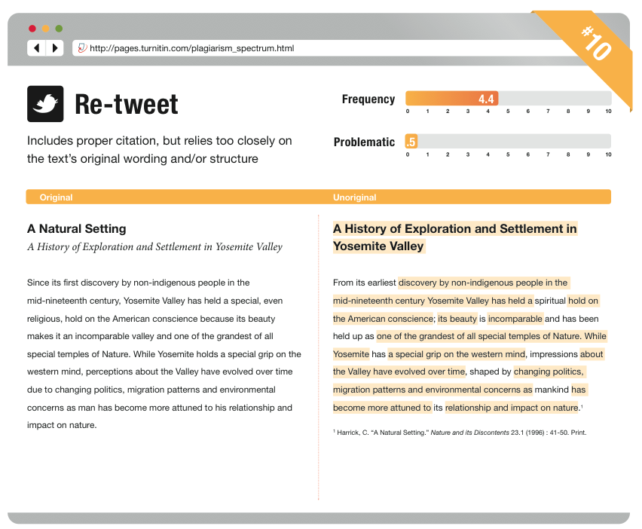
Notes:
Last, we have the “Re-tweet,” which includes proper citation, but relies much too closely to the original. Our survey respondents reported that they encountered this moderately frequently. And, interestingly reported that it was not that problematic. One of the questions that the appearance of a frequent re-tweeting in a paper would arise for me is whether the student in relying on the text is also relying too much on the original sources ideas for the paper or assignment.

Slide 18
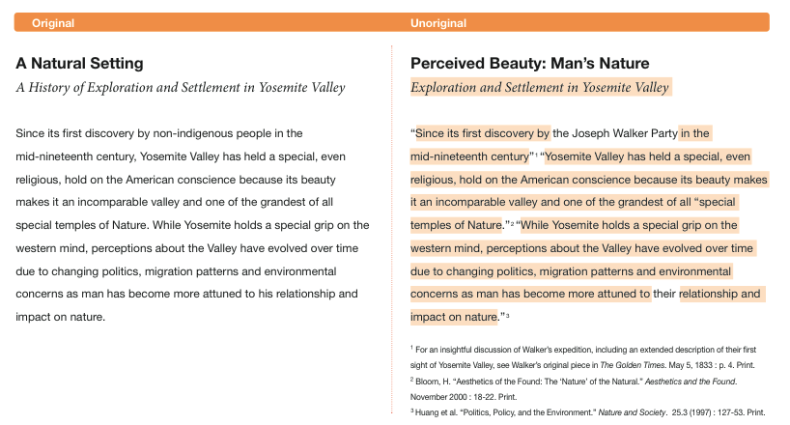
Which Type?
From the ten described, this type of plagiarism should be tagged as:
Notes:
Q: Out of all ten described, this type of plagiarism should be tagged as:
Put into Poll:
Recycle
CTRL-C
Hybrid
Find-Replace
Aggregator
Re-tweet
404 Error
Hybrid
Mashup
Clone
A: 404 Error

Slide 19
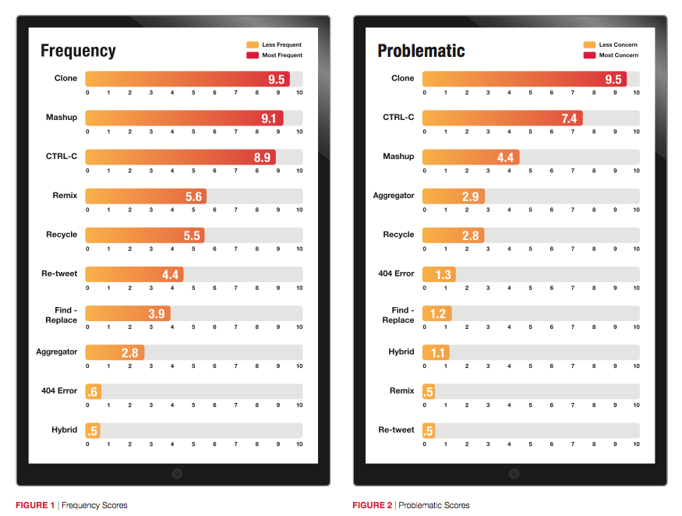
Notes:
This slide shows the Frequency and Problematic Rankings of the types. Again, this is from survey results so you may see something different in your classroom. Nonetheless, its interesting to see Clone, CTR-C and Mashup, ranking in the top for both categories.

Slide 20
Is it Plagiarism or Not?

Slide 21
Example 1: Wikipedia
You’ve asked your students to create a Wikipedia entry on a topic of their choice. One of your students has chosen to write an entry on “music sampling.” Trying to be clever (“the medium is the message”), he wholesale copies from an existing Wikipedia entry on “music sampling.”
The student claims too that there was no guidance on the Wikipedia entry about attribution.
Is this plagiarism or not?

Slide 22
Example 2: Use of Images
Your student has included a number of images—clearly sourced somewhere online—and included them in her PPT presentation for your media studies class. None of these images are accompanied by any attribution information or citation.
You ask the student why there are no citations, and she tells you that it’s because these are “stock” images that she purchased.
Is this plagiarism or not?

Slide 23
Example 3: Paper for Hire
In your “copyright” course, a student has hired a ghost writer to write his final paper on the topic of copyright and its enforceability in the context of ghost-written content.
The student has a “work for hire” contract with the writer that he has hired to write the paper. The contract makes clear that the student owns all the work that the contracted ghost writer has written.
Is this plagiarism or not?

Slide 24
Classroom Activities

Slide 25
How Can I Apply This in a Classroom?
Games: Matching
Group Activity: Jigsaw, performance, etc.
“Is it Plagiarism or Not?” Activity
Review the Plagiarism Spectrum in Class

Slide 26
Thank you!
Turnitin Professional Development Team
Kristin Brabec - kbrabec@turnitin.com
Chris McClure– cmcclure@turnitin.com
Jason Chu - jchu@turnitin.com

